Slide 1
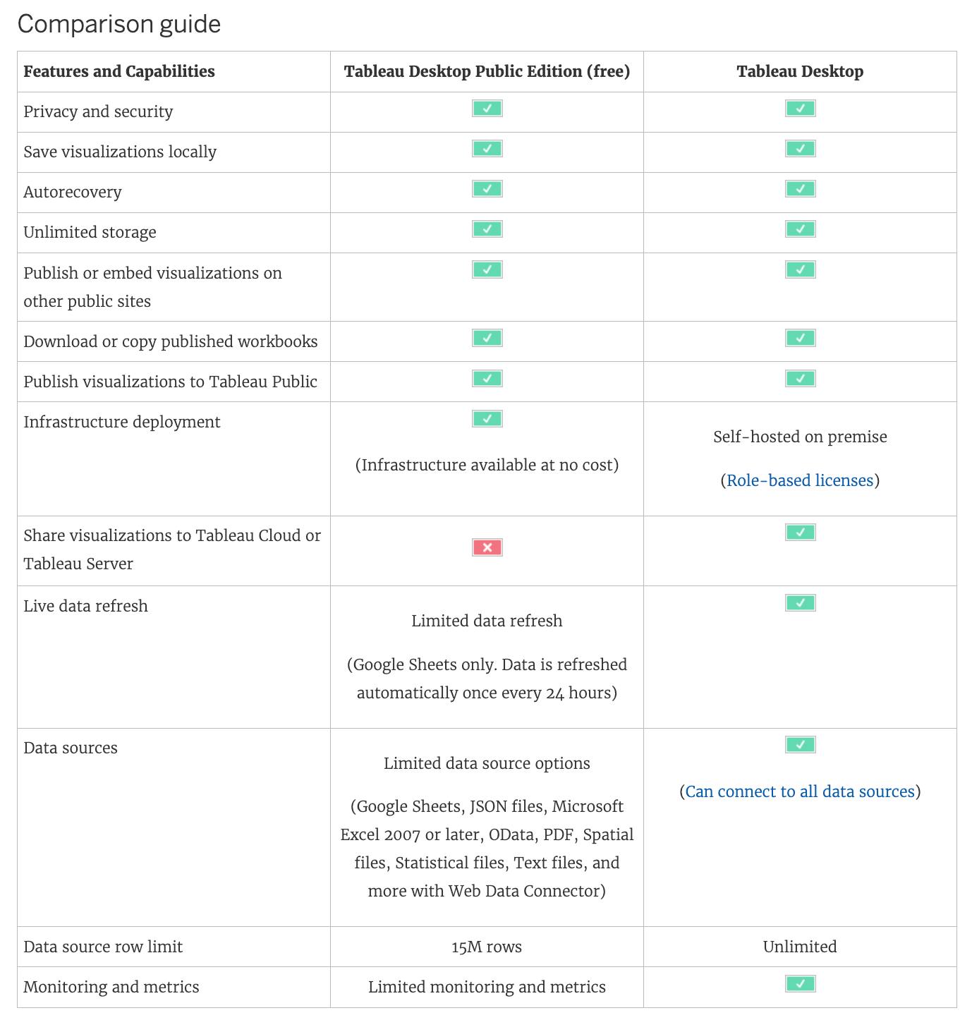
Product Comparison Guide

Slide 2
Product Comparison Guide

Slide 3
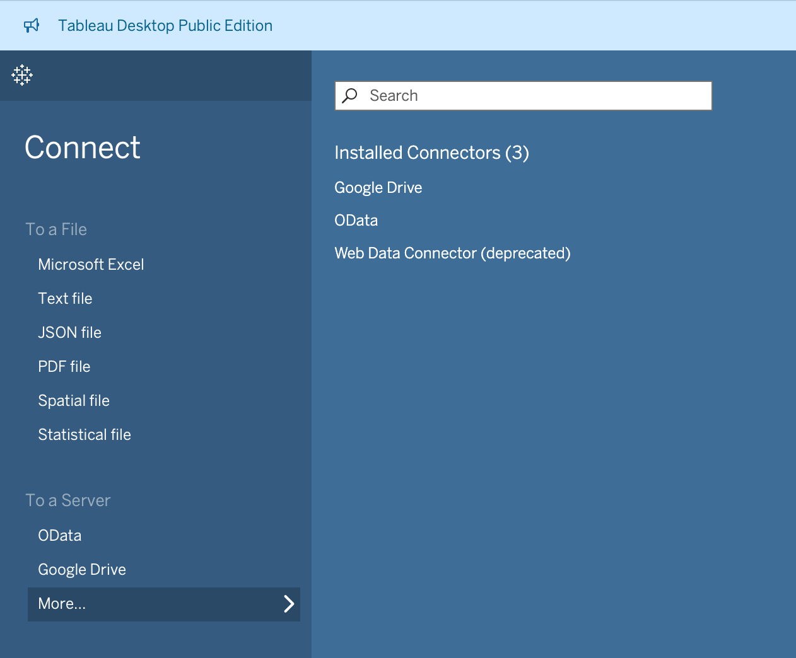

Slide 4
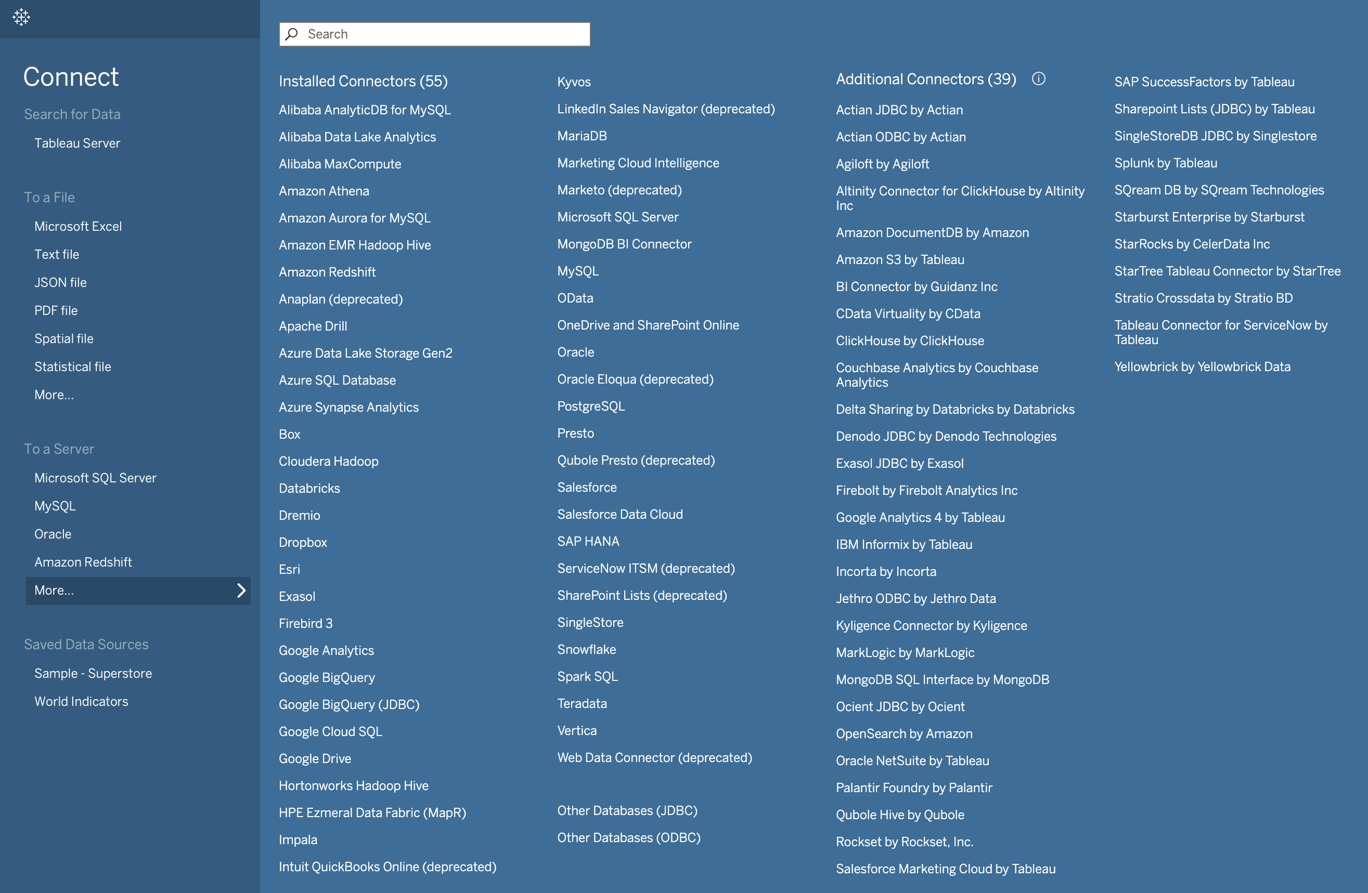

Slide 5
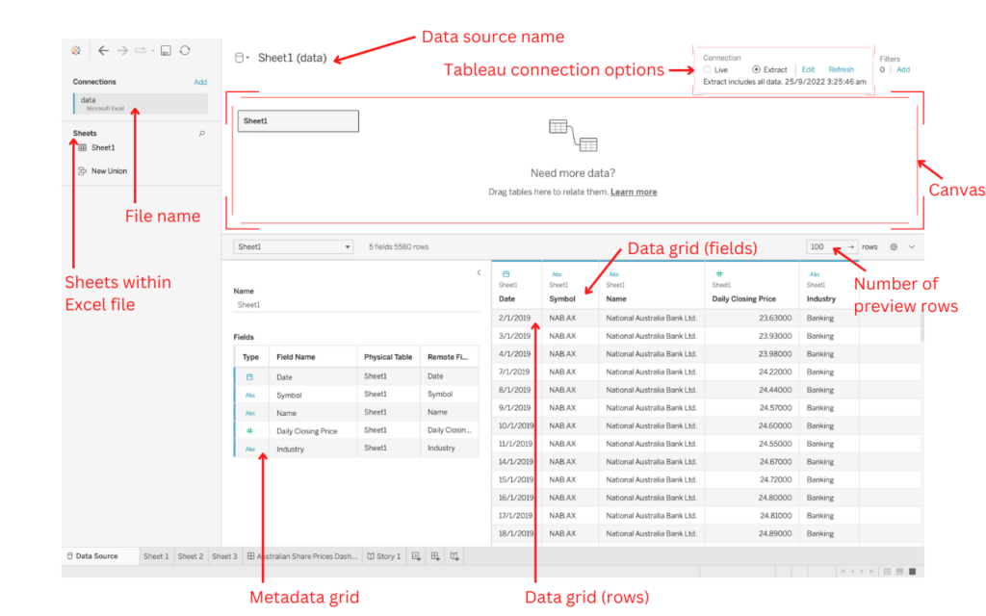
Data Source Interface
Source:
Tableau Help

Slide 6
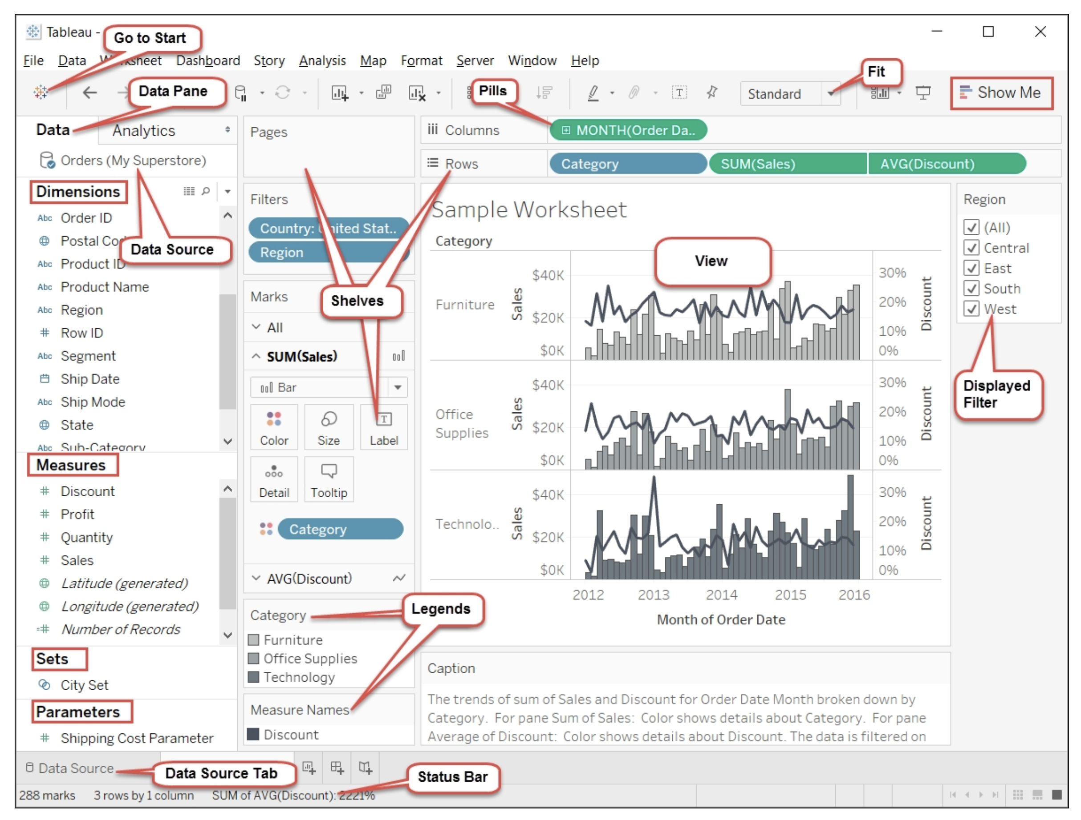
WorkspaceInterface
Source:
O’Reilly Mastering Tableau by David Baldwin

Slide 7
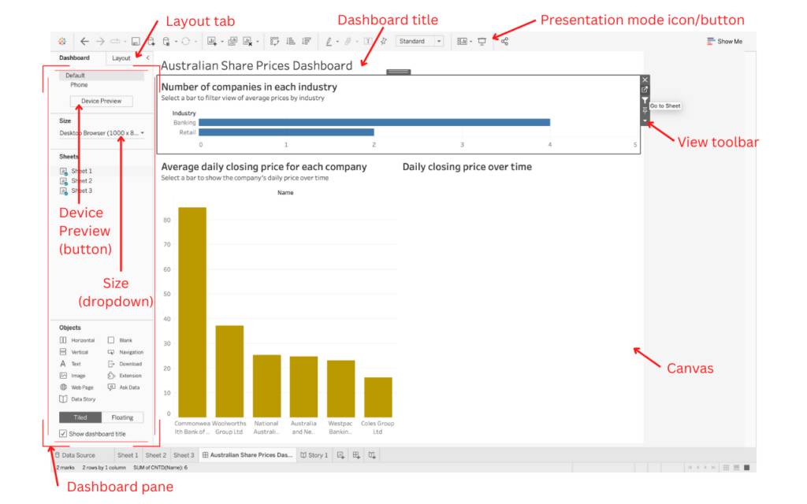
Dashboard
Interface
Source:
O’Reilly Mastering Tableau by David Baldwin
Source: The Tableau Desktop workspace/interface guide by Jason Khu
https://jason-khu.com/the-tableau-desktop-workspace-interface-guide/

Slide 8
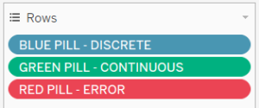
A shorter answer …
Dimensions usually cannot be aggregated (summed, averaged etc), whereas measures can be.

Slide 9
Data Categories: Dimension vs Measures
Blue and Green Pills
Dimensions are qualitative, meaning they can't be measured but are instead described. Dimensions are often things like city or country, eye color, category, team name, etc. Dimensions are usually discrete.
Measures are quantitative, meaning they can be measured and recorded with numbers. Measures can be things like sales, height, clicks, etc. In Tableau Desktop, measures are automatically aggregated; the default aggregation is SUM. Measures are usually continuous.

Slide 10
Data Categories: Dimension vs Measures
Blue and Green Pills
Discrete means individually separate or distinct. Toyota is distinct from Mazda. In Tableau Desktop, discrete values come into the view as a label and they create panes.
Continuous means forming an unbroken, continuous whole. 7 is followed by 8 and then it's the same distance to 9, and 7.5 would fall midway between 7 and 8. In Tableau Desktop, continuous values come into the view as an axis.
Dimensions are usually discrete, and measures are usually continuous. However, this is not always the case. Dates can be either discrete or continuous.

